Slide 1
Texas CDBG-CARES
Community Resiliency Program (CRP)
Section 3 Presentation
(SAMPLE)
(DATE)

Slide 2
Grant Information
The [City/County] recently received the following grant award:
Contract No. [##]
Award Amount: [$XXX,XXX]
Project: [description]

Slide 3
Grant Information
The grant is funded through the Community Development Block Grant, via:
U.S. Department of Housing and Urban Development
and
Texas Department of Housing and Community Affairs

Slide 4
Section 3 Concepts
As a condition of funding, the [City/County] must comply with Section 3 of the Housing and Urban Development Act of 1968.
To the greatest extent feasible, Grant Recipients must direct economic opportunities generated by CDBG funds to low- and very low-income persons.

Slide 5
Section 3 Concepts
In part, this means ensuring that:
  Section 3 Businesses have the information to submit a bid or proposal for the project; and
  Section 3 Workers have information about any available job opportunities related to the project.
For precise definitions, see CRP Section 3 Guidance

Slide 6
Section 3 Business
A company may qualify as a Section 3 Business if:
  it is owned by low-income persons;
  it is owned by Section 8-Assisted housing residents; or
  75% of all labor hours for the business in a 3 month period are performed by Section 3 Workers
Register at:
HUD’s Section 3 website: https://portalapps.hud.gov/Sec3BusReg/BRegistry/RegisterBusiness
[local/regional registry for disadvantaged businesses if applicable]

Slide 7
Section 3 Business
This project is expected to include the following contracting opportunities:
Grant Administration services (previously selected)
Engineering Services (previously selected)
Prime Contractor for [short description]
Subcontractors for [list trades]
[note: list all bid and/or small purchase opportunities expected for the project]

Slide 8
Section 3 Worker
You may qualify as a Section 3 Worker if:
  Your annual income is below the county threshold for your family size:
  You are a current or recent Youthbuild participant
Register your information and search for opportunities at:
  WorkInTexas.gov
  HUD’s Section 3 Opportunity Portal https://hudapps.hud.gov/OpportunityPortal/
  [local/regional job board if applicable]

Slide 9
Targeted Section 3 Worker
Section 3 Workers that reside near the project location may also qualify as Targeted Section 3 Workers.
For this project, that service area is defined by this map:
[Service Area Map here]

Slide 10
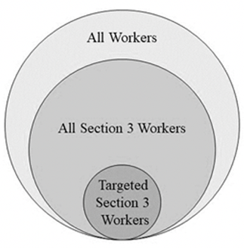
Recordkeeping
The [City/County] will track all hours worked on the project based on the three categories of workers.
This will require collection of certain income information.

Slide 11
More Information
CRP Section 3 & Project Construction Guidance
24 CFR Part 75
Electronic Code of Federal Regulations (eCFR)
[name of local contact]

